Slide 1
Modern Data Structures

Slide 2
Course Outline
Week 1: Introduction
  What is data and how can it be organized
  Review of Python basics

Slide 3
Course Outline
PART I: Data Manipulation and Coding
  Github and virtual environments
  Numpy array objects
  Data wrangling with Pandas
  Functions I: Basic structure and logic
  Functions II: For loops, nested and complex operations
  Working with strings and classes in Python
  Testing

Slide 4
Course Outline
PART II: Python and leveraging other software tools
  Textual data
  Working with APIs
  Working with SQL
  Web scraping from HTML

Slide 5
Course Outline
PART II: Advanced topics
  LLMs and Vibe coding
  Cloud computing

Slide 6
Data

Slide 7
Social science data
Information collected about human behavior, societies, and social phenomena to answer questions, test theories, and draw conclusions about social life.
Qualitative (surveys, interviews, text)
Quantitative (numeric)

Slide 8
Key question
How do we reliably turn messy, real-world data into analysis-ready data?
Collection
Organization
Cleaning
Analysis

Slide 9
Key concepts
Observational identity: Variables (possibly multiple) that uniquely define each observation.
Unit of analysis: The level at which observations should be organized and interpreted.
Replicability: Code produces the same results given the same data and conditions.
Documentation: Code can be easily understood by others
Assumptions: Choices and constraints made when putting data together
Validation: Evidence that the data and transformations are plausible and correct

Slide 10
Numeric data structures
One-dimensional data
  Time-series or cross-section data
Two-dimensional data
  Panel data or cross-section, time-series data
Three-dimensional data
  Panel data at disaggregated level
    Subnational data by country over time
    Product level imports or exports by country over time

Slide 11
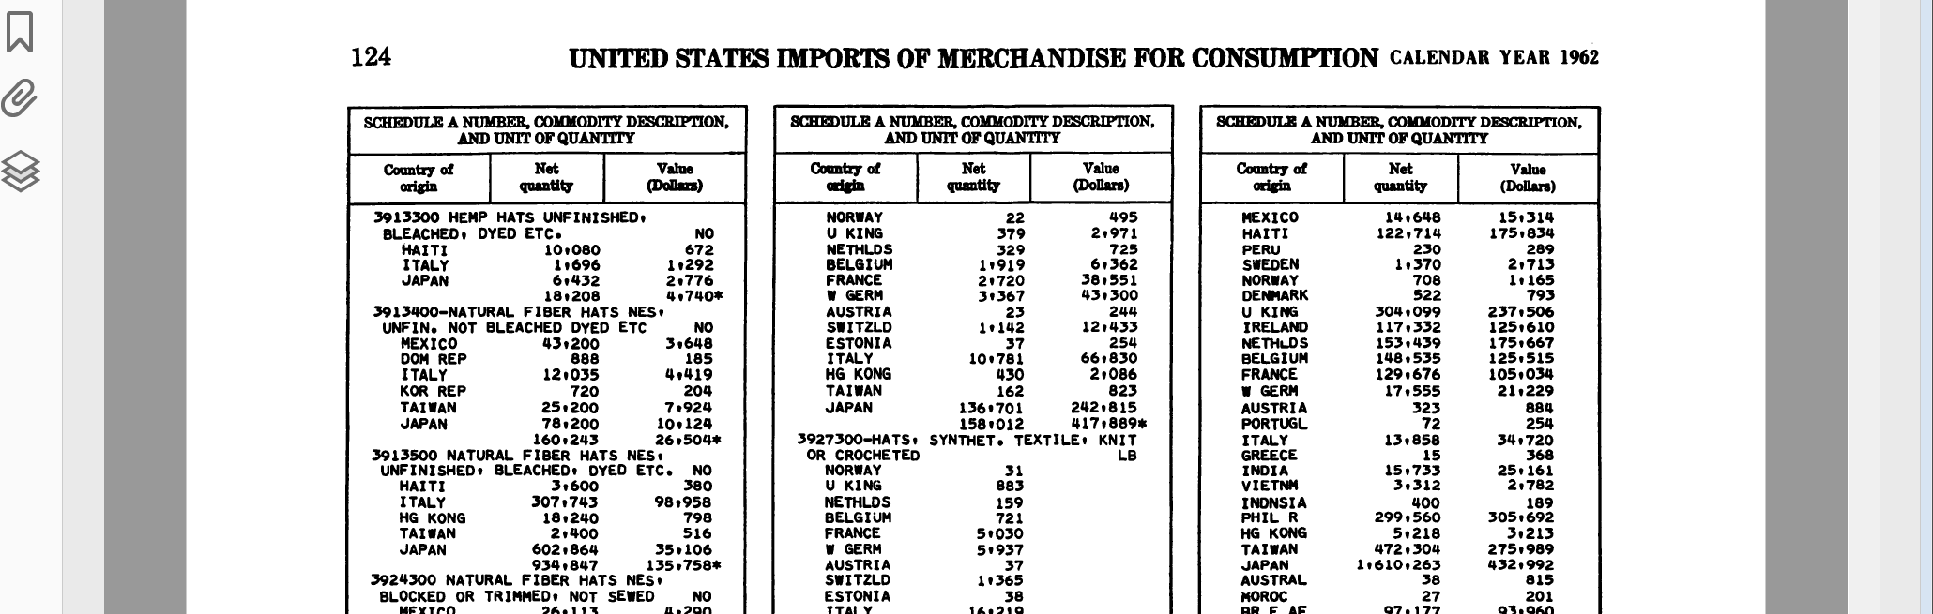
Types of data - numeric
Lesson 1 - Organizing data
Notes:
With numeric data, it is easier to see how to organize and structure data.
Here’s an example of data that I work with in my other role as an international political economy scholar
This is part of a 200 page document on United States trade by commodity and country for the year 1962
For each commodity it list the number and the description, then each country, the quantity of the good the U.S. imported from that country, and then the value of the good.

Slide 12
Data transformed
Commodity | Description | Country | Value
3913300 | Hemp hats, unfinished, bleached, dyed, etc | HAITI | 672
3913300 | Hemp hats, unfinished, bleached, dyed, etc | ITALY | 1292
3913300 | Hemp hats, unfinished, bleached, dyed, etc | JAPAN | 2776
3913300 | Hemp hats, unfinished, bleached, dyed, etc | WORLD | 4740
3913400 | Natural fiber hats, nes, unfin, not bleached, dyed, etc | MEXICO | 3648
3913400 | Natural fiber hats, nes, unfin, not bleached, dyed, etc | DOM REP | 185
3913400 | Natural fiber hats, nes, unfin, not bleached, dyed, etc | ITALY | 4419
3913400 | Natural fiber hats, nes, unfin, not bleached, dyed, etc | KOR REP | 204
3913400 | Natural fiber hats, nes, unfin, not bleached, dyed, etc | TAIWAN | 7924
3913400 | Natural fiber hats, nes, unfin, not bleached, dyed, etc | JAPAN | 10124
3913400 | Natural fiber hats, nes, unfin, not bleached, dyed, etc | WORLD | 26504
3913500 | Natural fiber hats nes, uniinished, bleached, dyed, etc. | HAITI | 380
3913500 | Natural fiber hats nes, uniinished, bleached, dyed, etc. | ITALY | 98958
3913500 | Natural fiber hats nes, uniinished, bleached, dyed, etc. | HG KONG | 798
3913500 | Natural fiber hats nes, uniinished, bleached, dyed, etc. | TAIWAN | 516
3913500 | Natural fiber hats nes, uniinished, bleached, dyed, etc. | JAPAN | 35106
3913500 | Natural fiber hats nes, uniinished, bleached, dyed, etc. | WORLD | 135758
Lesson 1 - Organizing data
Notes:
- The data is easily structured

Slide 13
Types of data - Qualitative
Central bank independence
Chief Executive Officer (weight = .20)
Term of office
Swaziland 1979: Subject to sections 11 to 14 inclusive, the governor shall be appointed and may be removed from office by the King in consultation with the Prime Minister and the other directors shall be appointed and may be removed from office by the Minister. (Section 10)
The governor and the deputy governor shall be persons of recognized qualification and experience in financial matters, and shall be appointed for a term not exceeding five years. (Added in 2004)
Subject to this Order, the governor and the deputy governor shall be appointed on such terms and conditions as may be set out in their letters of appointment, and shall be eligible for reappointment. (Section 11) (Coded as .5 from 2004)
Who appoints CEO?
Swaziland 1979: Subject to sections 11 to 14 inclusive, the governor shall be appointed and may be removed from office by the King in consultation with the Prime Minister and the other directors shall be appointed and may be removed from office by the Minister. (Section 10) (Coded as 0)
Dismissal
Swaziland 1979: Subject to sections 11 to 14 inclusive, the governor shall be appointed and may be removed from office by the King in consultation with the Prime Minister and the other directors shall be appointed and may be removed from office by the Minister. (Section 10) (Coded as 0)

Slide 14
Human Coding: Central bank independence
Chief executive officer (CEO) 0.20
  a. Term of office
    Over 8 years 1.00
    6 to 8 years 0.75
    5 years 0.50
    4 years 0.25
    Under 4 years or at the discretion of appointer 0.00
  b. Who appoints CEO?
    Board of central bank 1.00
    A council of the central bank board, executive branch, and legislative branch 0.75
    Legislature 0.50
    Executive collectively (council of ministers) 0.25
    1 or 2 members of the executive branch 0.00
Chief executive officer (CEO) 0.20
  c. Dismissal
    No provision for dismissal 1.00
    Only for reasons not related to policy 0.83
    At the discretion of central bank board 0.67
    At legislature's discretion 0.50
    Unconditional dismissal by legislature 0.33
    At executive's discretion 0.17
    Unconditional dismissal by executive 0.00

Slide 15
Text data
339. Memorandum From President Nixon to the Chairman of the Washington Special Actions Group (Kissinger)¹
Upon the successful conclusion of U.S. ground operations in Cambodia, I want to re-emphasize to you and, through you, to the Washington Special Actions Group and the Departments concerned, that I place great emphasis on the need to redouble our efforts to provide appropriate military equipment and supplies to the Government of Cambodia.
I continue to believe that it is in our best interest to prevent Cambodia from falling under Communist control and I expect the Washington Special Actions Group to concentrate its efforts toward that end.
Termination of U.S. ground operations in Cambodia also underlines the desirability of maintaining maximum pressure on the enemy in Cambodia through U.S. and allied air efforts. For this reason, I want to reaffirm until further notice, all authorities heretofore promulgated for the conduct of U.S. air operations over Cambodia.
Richard Nixon

Slide 16
Assumptions
What choices, explicit or implicit, were made when constructing dataset?
What is missing, excluded, or imputed?
What decisions were made silently?
Examples:
  Dropping rows with missing values
  Choosing one source over another
  Treating categories as comparable
  Import versus export data

Slide 17
Validation
How do we know the data is correct, not just reproducible?
Sanity checks, constraints, expectations
Does the data match reality?
Example:
  Proxies

Slide 18
Idiosyncrasies in Python
Indentations and white space in loops
Stata:
  forval i 2000/2010 {
  di “The year is `i‘”
  }
R:
  for(i in 2000:2010){
  print(paste(“The year is”,i)
  }
Python
  for i in range(2000:2010):
  print(“The year is” + str(i))

Slide 19
Indexing
Python starts indexing elements with 0
  >>> elec_data['State'][1]
  'Alaska'
  >>> elec_data['State'][0]
  'Alabama‘

Slide 20
Copies
Python does not make separate copies of objects
Objects are always attached or linked
Changes to one object will be made to copy
  Really annoying

Slide 21
Python objects
Key objects
  list (ordered, mutable)
  tuple (ordered, immutable)
  set (unique, unordered)
  dictionary (key→value mapping)
Mutable: Object can be changed after creation
Ordered: Elements have defined, consistent position
  Can be indexed

Slide 22
Lists
Syntax: [1, 2, 3]
Ordered and indexable (supports slicing)
Mutable: append, insert, pop, sort
Allows duplicates; membership test is O(n)
Good for ordered sequences you build or modify

Slide 23
Tuples
Syntax: (1, 2, 3)
Ordered and indexable, but immutable (no append/pop)
Slightly lower memory overhead vs lists
Can be used as dict keys if all elements are hashable
Ideal for fixed records and multiple return values

Slide 24
Sets
Syntax: {1, 2, 3} or set([...])
Unordered: no reliable index or order in iteration
Enforces uniqueness — ideal for deduping
Fast membership checks and set algebra (union, intersection) — average O(1)
Not suitable if you need a preserved order

Slide 25
Dictionaries
Syntax: {'a': 1, 'b': 2}
Keys must be hashable and unique; values can be anything
Fast lookups by key (average O(1)); preserves insertion order (Python 3.7+)
Useful for structured data, lookups, and caches
Methods: .get(), .items(), .keys(), .values(), .setdefault()

